Slide 1
SPECIALLY ABLED HELPING KIT
CIS HACKATHON

Slide 2
INTRODUCTION

Slide 3
GOGGLES
Enables contact free obstacle detection
Direction in line of sight
Alerts changes in light intensity
Enables live tracking

Slide 4
BAND
Means for deaf people to communicate normally
Uses morse code
Gives output through vibrations
Linked with an android application

Slide 5
BLIND MAN’S GOGGLES

Slide 6
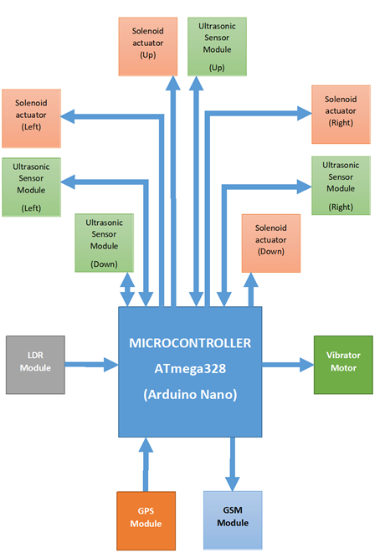
BLOCK DIAGRAM

Slide 7
BLOCK DIAGRAM
Detects obstacles in line of sight
Improves security
Helps in light detection
Easy to wear
Easy handling

Slide 8
PROXIMITY SENSOR

Slide 9
WORKING
4 ultrasonic sensors in 4 directions(left, right, up and down)
Each ultrasonic sensor sends a sound signal
They hit an obstacle and bounce back
Receiver receives the signal
Time taken for response is taken by arduino
This time is used to calculate distance

Slide 10
WORKING
The distance is categorized according to the proximity
Each category gives an output voltage to solenoid
Where voltage ∝ proximity
Variable pressure is applied on users skin
Where pressure ∝ voltage

Slide 11
WORKING
More pressure ⇒ very close obstacle
Less pressure ⇒ far away obstacle

Slide 12
LIGHT INTENSITY DETECTION

Slide 13
WORKING
LDR detects the ambient light
During each iteration, checks if new value >= 1.5(old value)
If yes the motor gives out 1s vibration
Otherwise checks if its <= 0.5(old value)
If yes, gives out 2 short vibrations
This value is stored for future iterations

Slide 14
TRACKING DEVICE

Slide 15
GPS MODULE
Arduino requests location from GPS Module
Module sends the string message
Message is parsed and co-ordinates are retrieved
Coordinates are received by arduino
Coordinates are sent to user through GSM

Slide 16
GSM MODULE
GSM module receives SMS message.
Arduino checks message for authentication code.
If authentication successful get location info.
Location info taken from GPS module.
Arduino converts the raw latitude and longitude to Google Maps link.
Google Maps link is sent as SMS message.

Slide 17
BODY
[GOGGLES]

Slide 18
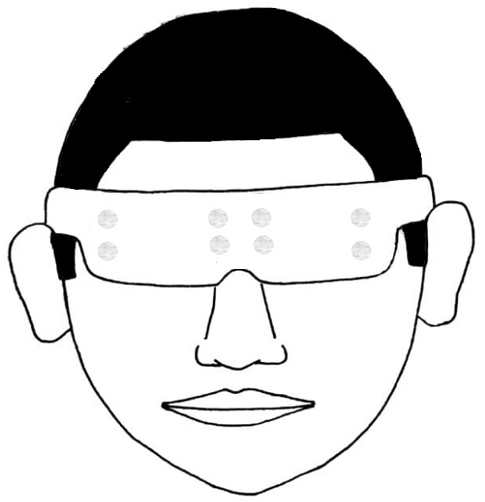
DESIGN
Encloses all electronic components in body
Battery kept on strap
Glow in dark sticker
Easy concealed buckle

Slide 19
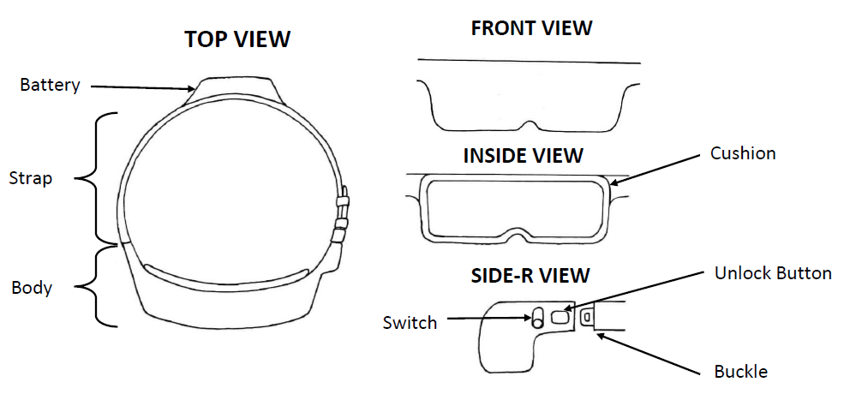
DESIGN

Slide 20
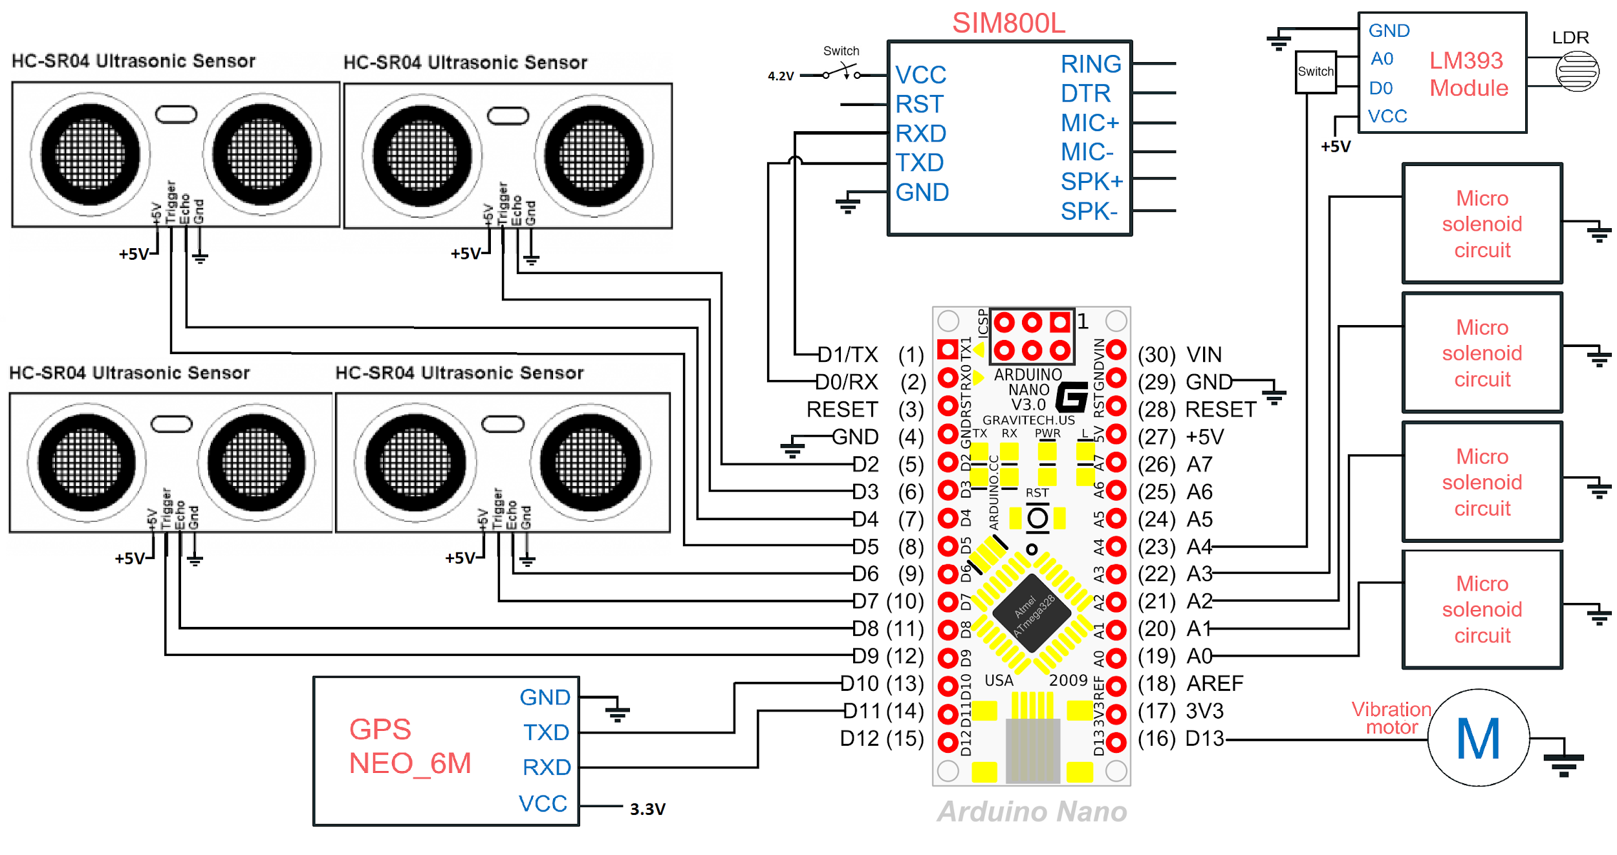
INTERFACING

Slide 21
Declaration of Pins and Variables
SMS String
==Password
SMS String=NULL
Delay
100ms
false
true
High pulse at trigger of all ultrasonic sensor modules
Store prev value=new value
Get GPS Values
Wait for echo
false
Give two short HIGH pulse to vibrator
New value<= 0.5x prev value
true
Add Phone number
Echo=High
ALGORITHM
false
true
false
Add Location Info
Give HIGH value to vibrator for 1 sec
New value>=
1.5x prev value
Calculate Distance (d)
true
Send SMS with GPS info
d<15cm
true
Solenoid O/P=5V
Read LDR
Analog IN
false
false
d<30cm
true
Solenoid O/P=4.2V
D<50cm
Solenoid O/P=3.5V
true
false

Slide 22
COM BAND

Slide 23
WORKING AND DESIGN
Modified bluetooth headphone
Connection with phone similar to normal bluetooth headphones
Inbuilt microphone used to receive audio signals
Speakers replaced with vibrator motors giving morse code output

Slide 24
ANDROID APPLICATION

Slide 25
PURPOSE OF THE APP
Recognizes speech
Converts it into text
Converts the text into morse code
Morse code to audio signal

Slide 26
CONCLUSION

Slide 27
GOGGLES
Effective contactless obstacle detection
Improved security though tracking
Light detection
Easy wearing
Cost effective

Slide 28
BAND
Enables easy communication for people with hearing disability
Recognizes speech for them
Reduces the gap of communication

Slide 29
DEMO VIDEO

Slide 30
LINK FOR VIDEO FOLDER
https://drive.google.com/drive/folders/1P-ScGVR52XshVf2SPGJ6gV0zlWmuWuIJ?usp=sharing

Slide 31
THANK YOU

